Slide 1
Paper Charts
VisCollage

Slide 2
Server
(python)
Client
(JS, HTML, CSS)
Index.js
drawPoster.js
PosterElement.js
Collage
tree_structurechart_datas
Draw Collage
Add Container
Generate Cluster
Headline Container
Main Container
Parent Container
Story Container
Side Navigation
Generate Layer
Optimal Scale Placement
Draw Major Plot
Draw General Plot
Draw Detail Plot
PosterLine.js
Generate NewPoster
Color,
Title,
Style,
Caption
PosterBar.js
Scale Region
Save SVG Features
PosterMap.js
PosterPie.js
Move Leaf Chart
Optimization
Dual Annealing
Objective Function
Comics
tree_structurechart_datas
Draw Comics

Slide 3



VisCollage

Slide 4
Stage 1 - Reassembling
C1. Affordance
C2. Compactness
C3. Thematic
C4. Relevance
Multiple Vis
Chart Syntax
Attribute Semantic
↓
Chart Groups
Clustering
Chart Groups
↓
Hierarchical Relations
Relating
Hierarchical Relations
↓
Pages and Plots
Allocating
Chart
Information
3-layer plots
Charts
Structure
Stage 2 - Rendering
3-layer plots
Layout Design
Collage Frame
Major Scene
General Scene
Detail Scene
Collage Vision
Statistical Facts
Extreme Facts
User-Focused Facts
C5. Configuration
C6. Consistency
C7. Annotation
Collage Caption
General Plot
Visual Collages
Major Plot
Detail Plot
Color Consistency
Annotation Placement

Slide 5
a1
Original Multi-Views
a5
m1
a1
a2
Y-axis
V1
Cluster Patterns
V2
m2
a1
a3
F(k1)
X-axis (a2)
m1
a1
a5
a2
CL1
a1 (f1)
V3
m2
a1
a4
F(k1)
F(k2)
a5 (f1)
Clustering
m2
a1
a5
a3
F(k1)
CL2
Y-axis
V4
m1
a5
a2
m2
a1
a5
a4
F(k1)
F(k2)
CL3
X-axis (a3)
V5
m2
a5
a3
F(k1)
a1 (f1_f2)
a5 (f1_f2)
V6
m2
a5
a4
F(k1)
F(k2)
Y-axis
X-axis (a4)

Slide 6
VIP
Member
Branch1
General
Revenue
Revenue
Branch1
Branch2
VIP
Member
General
Customer Level
Branch1
Branch2
Branch2
Revenue
Revenue
VIP
Member
General
VIP
Member
General
Customer Level
Customer Level

Slide 7
General
Major
Detail
CL1
CL2
CL4
CL1
Page 1
CL1
CL2
CL4
CL6
V1
V2
V3
CL2
CL3
CL6
Combine
&
Cluster
Plot
&
Paginate
V4
V7
V9
Page 2
CL1
CL2
CL4
CL8
CL4
CL5
V5
CL3
CL5
V6
V8
V10
CL6
CL8
CL7
Page 3
CL1
CL3
CL5
CL7
(a) Clustering
(b) Relating
(c) Allocating

Slide 8
CL8
CL1
CL2
CL4
V9
CL1
General
Major
Detail
V1
V2
V3
Page 1
CL6
CL1
CL2
CL4
CL6
V10
Hierarchies
CL2
CL3
Plot & Paginate
V4
V7
Page 2
CL4
CL5
CL1
CL2
CL4
CL8
V11
V5
CL3
CL5
Page 3
V6
V8
CL6
CL8
CL7
CL1
CL3
CL5
CL7
CL7
V12
(a) Clustering
(b) Relating
(c) Allocating

Slide 9
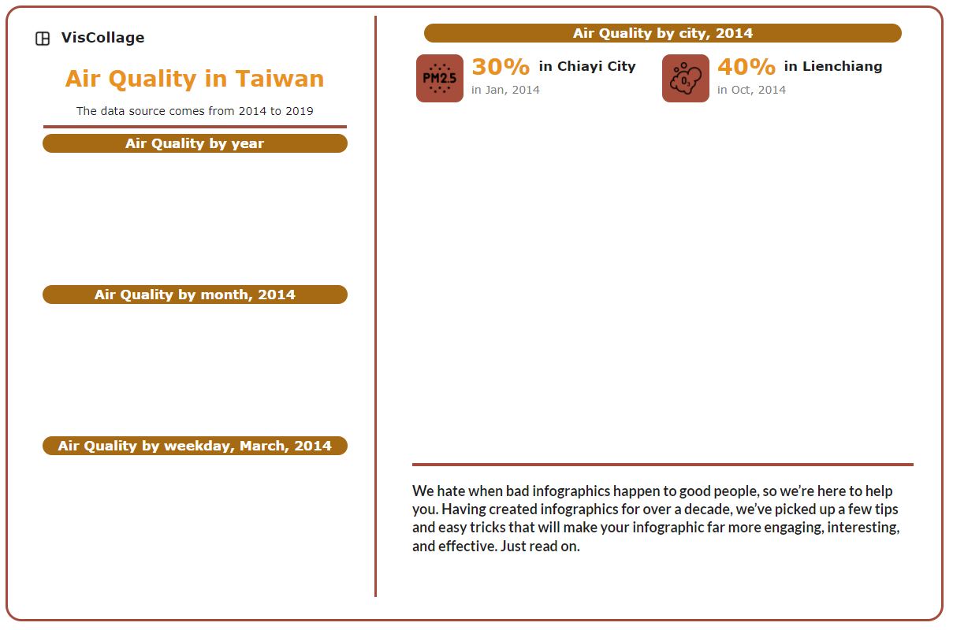
Major + Detail
Header
Statistical Overall Facts
General 1
General 2
General 3
User Focused Facts

Slide 10
SVG features
Point of Insights (POIs)
AnnoBox
Search Space Generation
Hierarchical Grid Search
Calculate Penalty
Search Optimal Placement
Place AnnoBox
Distance Penalty
Overlap Penalty
Update Search Space
Importance
Area
yes
i < n
no
End

Slide 11
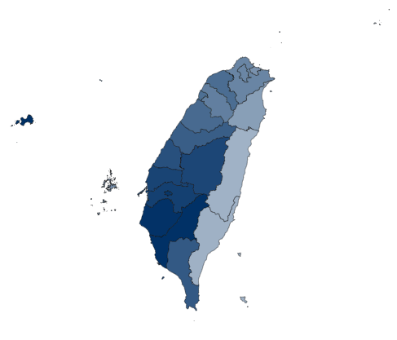





POI1 (x, y)
AnnoBox1
AnnoBox
1
r3 (x, y, w, h, α)
r₁
r₃
POI2 (x, y)
(w, h)
POI₁
AnnoBox2
r₂
POI₂
r2 (x, y, w, h, α)
(w, h)
r1 (x, y, w, h, α)
(w, h)
AnnoBox1
Chart Title
Legend1
Chart Title
Legend1
Chart Title
AnnoBox2
Legend2
Legend2
150
AnnoBox1
150
r4
AnnoBox1
AnnoBox2
Spring
r3
POI2 (x, y)
120
120
Summer
Attribute 1
Attribute 1
Autumn
90
90
Winter
60
60
Attribute 1
r2
AnnoBox2
AnnoBox1
30
30
Mon Tue Wed Thu Fri Sat Sun
Lower Middle Higher
r1 (x, y, w, h)
Attribute 2
Attribute 2
(a) Map Chart
(b) Line Chart
(c) Bar Chart
(d) Pie Chart

Slide 12

Request Bound
AnnoBox
1
AnnoBox
1
AnnoBox
2
Minimal Grid
AnnoBox1
AnnoBox2

Slide 13

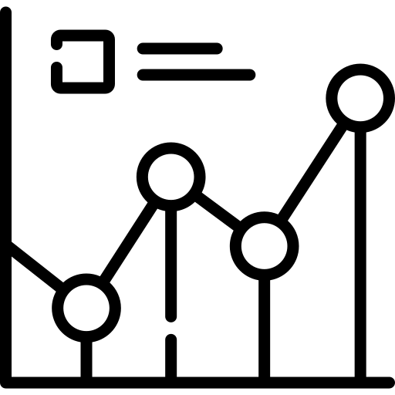

Model
Measures
Filters
Color
PM2.5
O3
...
["2019","2019_3", ...]
["2019","2019_3", ...]
...
Domain1
Domain2
...
Update Model
Query Model
Color Scheme
View
Controller
Assign Color
Range | Domain1 | Domain2 | Domain3 | Domain4
0 | #003065 | #652F00 | #006508 | #510065
1 | #0068b2 | #B25900 | #00B24E | #6F00B2
2 | #0095C7 | #C79D00 | #9DC700 | #A300C7
3 | #83c7e0 | #E0BE83 | #D1E083 | #C783E0
4 | #cbe5f1 | #F1E6CB | #DEF1CB | #EBCBF1
If m in Measures
If f in m.Filters
return m.Color[range]
Else append f
Else create m, f, Color
Ask
PM2.5 / O3
Year
PM2.5 / O3
Month
PM2.5 City
Request Color
Color
(a) MVC of Color Consistency
(b) Color Scheme

Slide 14
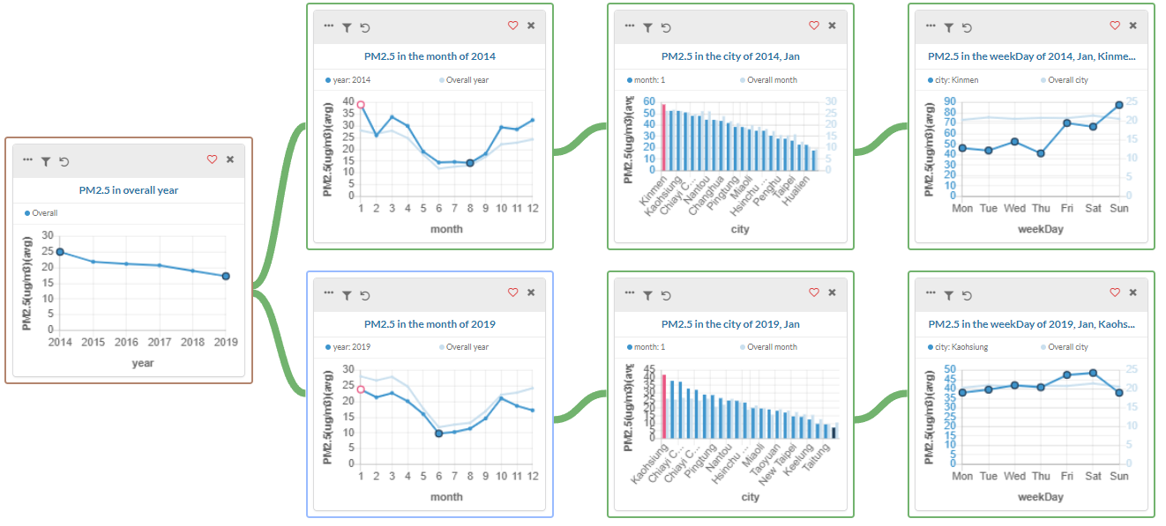
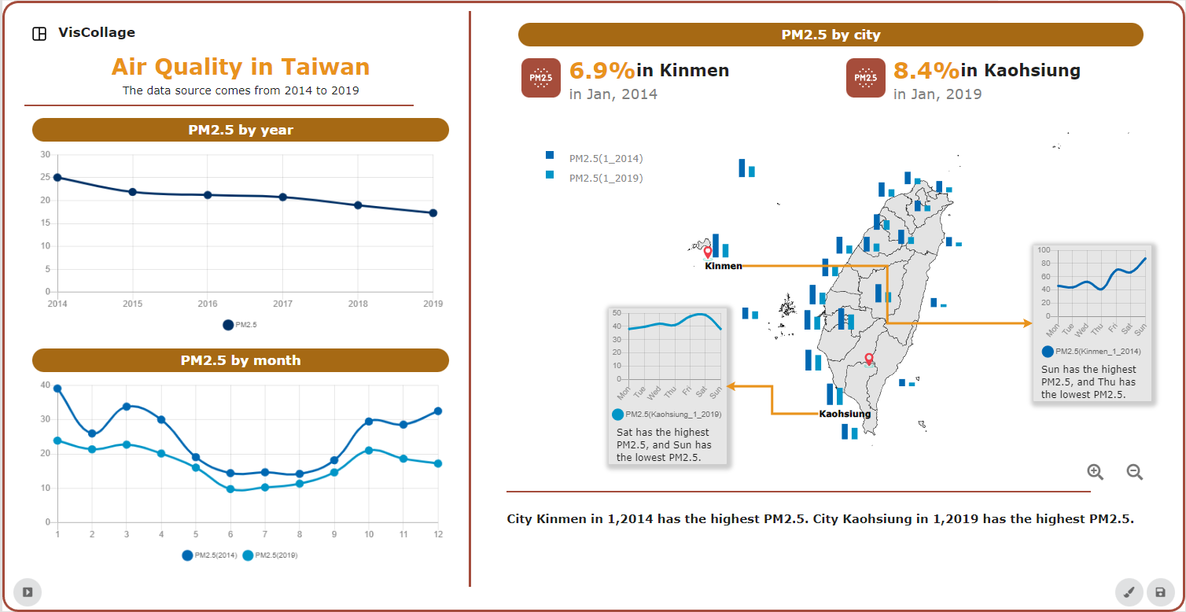
A
VisGuide
Stage 1 - Reassembling
Stage 2 –
Rendering
Clustering
Collage Frame
Relating
Collage Visual
Allocating
Collage Caption

Slide 15
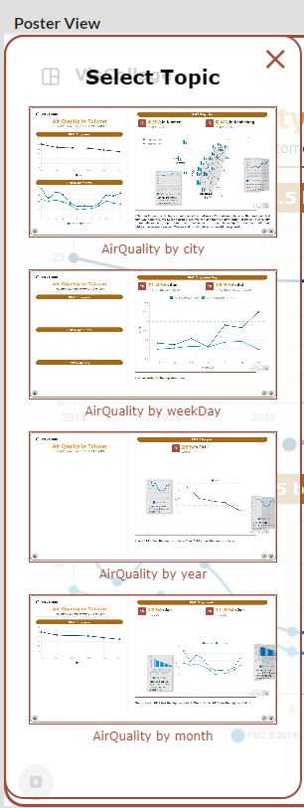
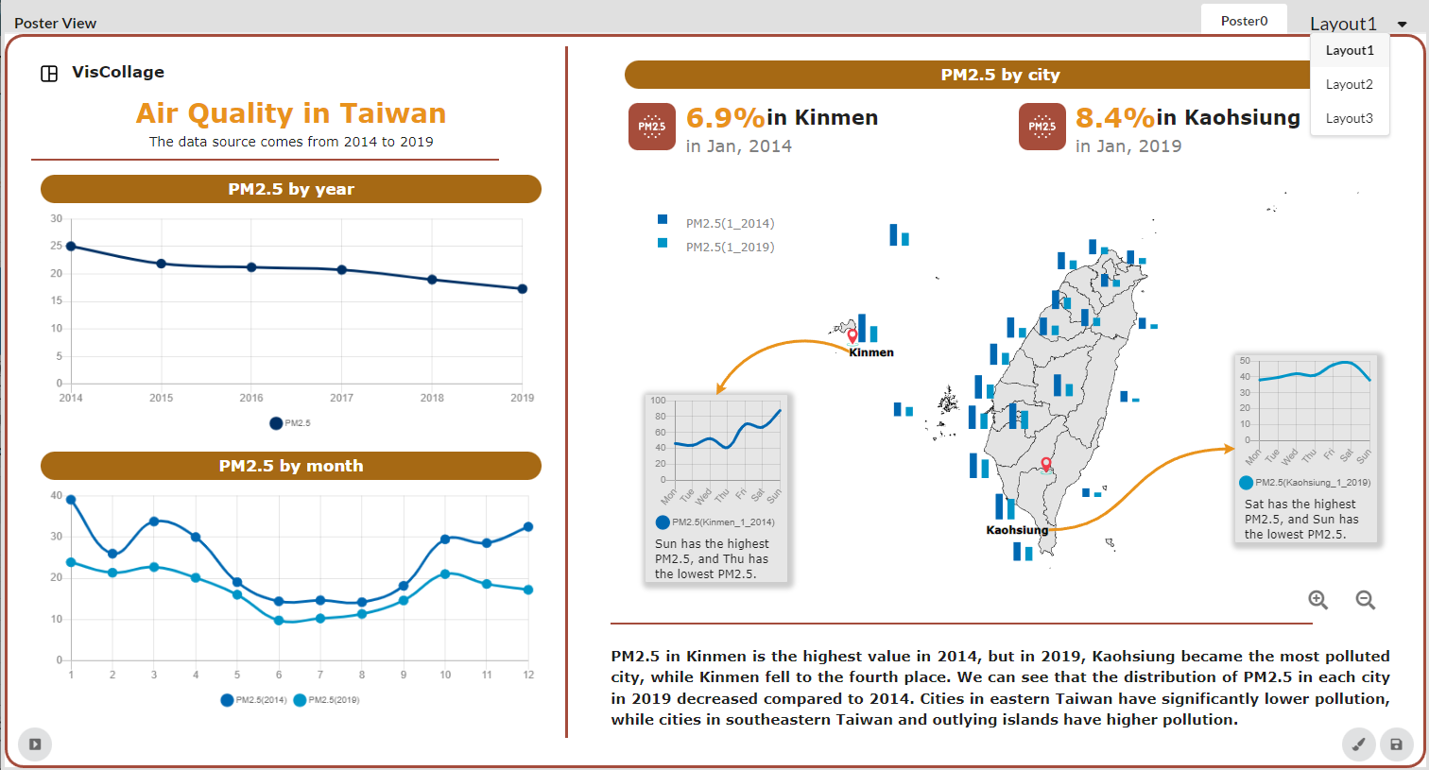
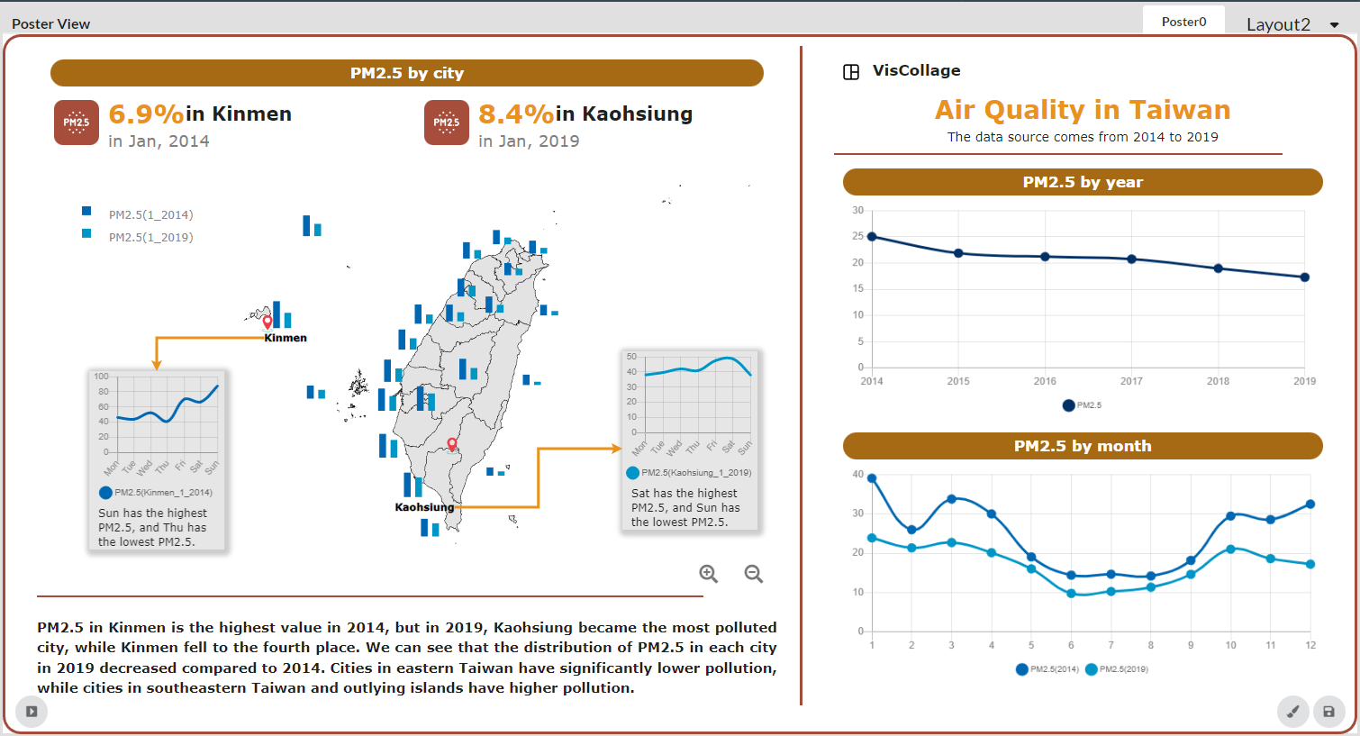
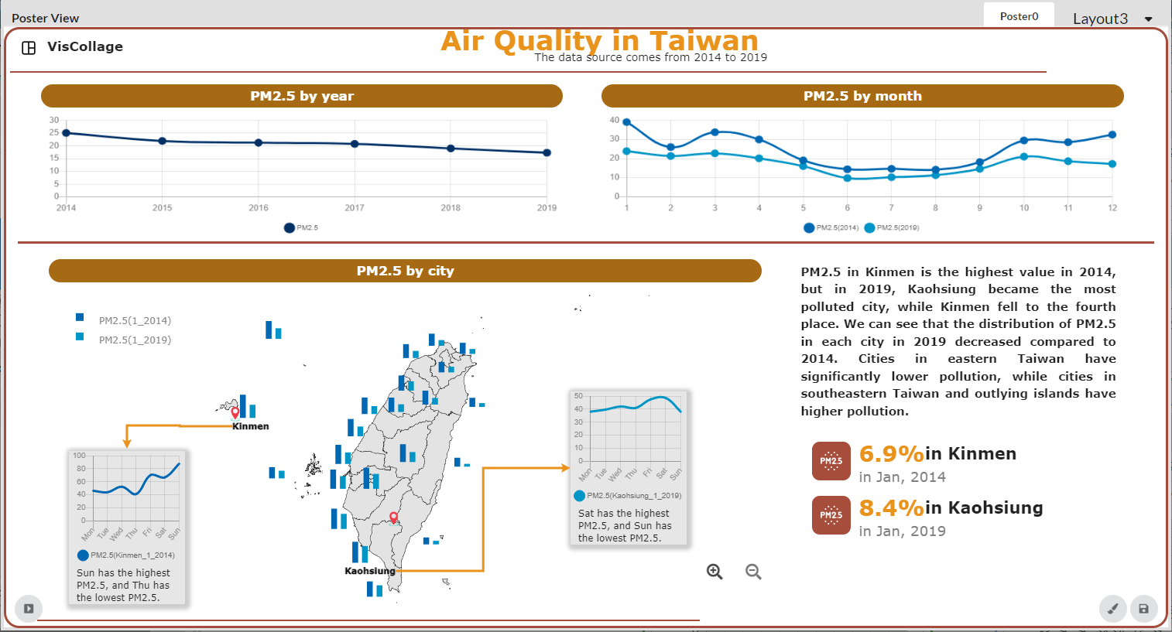
A
VisGuide
i
B
1
4
2
5
7
3
iii
6
ii
iv

Slide 16
Use Cases

Slide 17
A
VisGuide
B
i
1
4
2
5
7
3
iii
6
ii
iv

Slide 18
i
1
4
2
5
7
3
iii
6
ii
iv

Slide 19
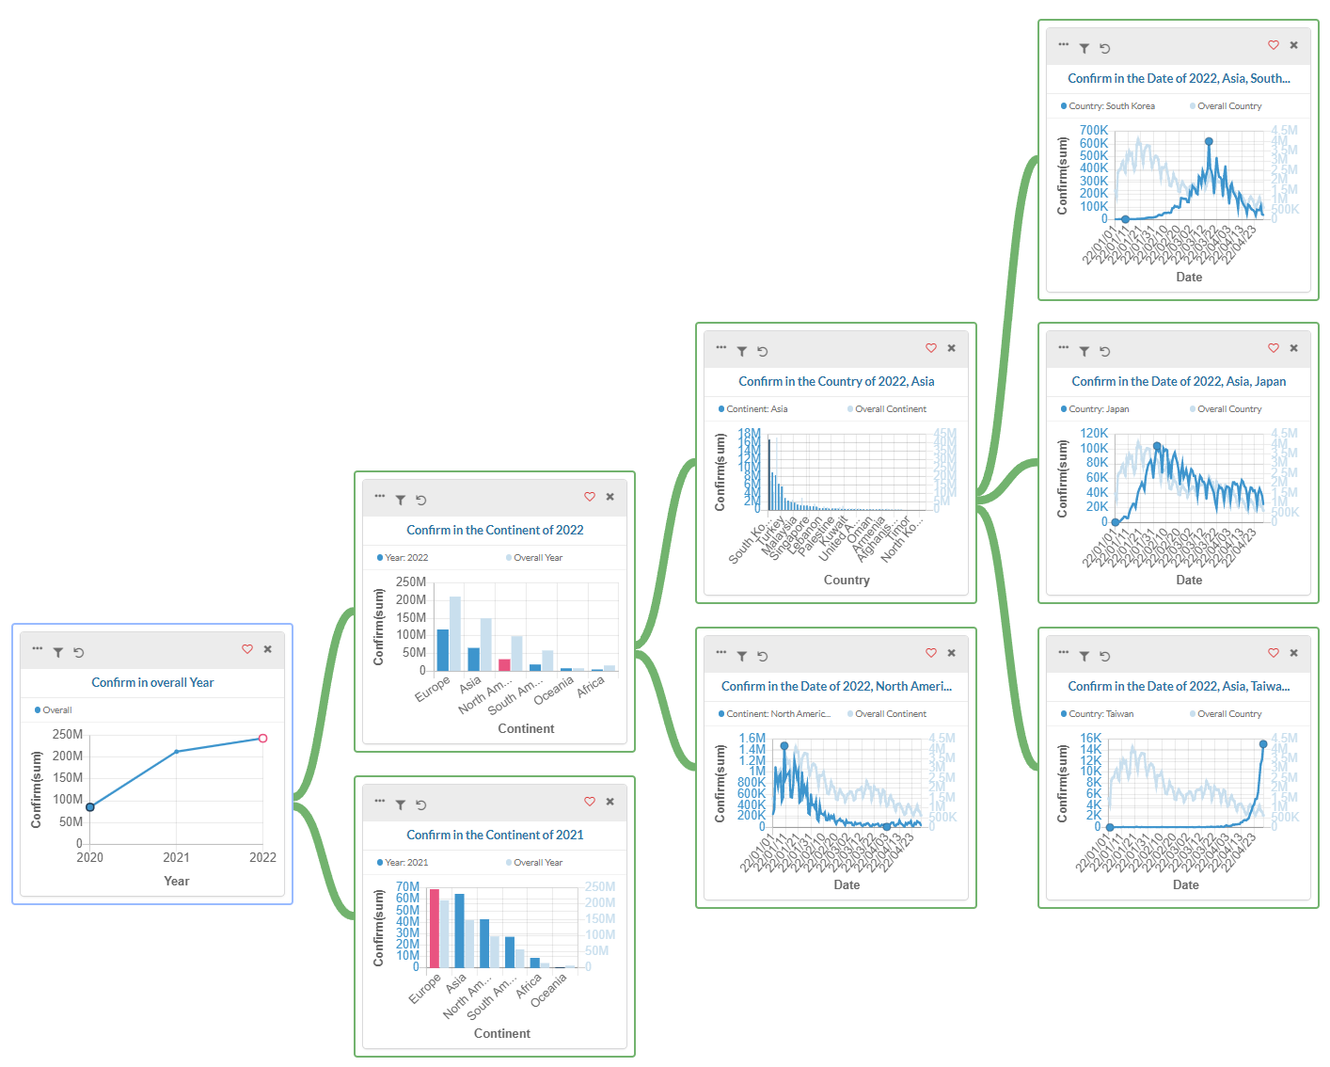
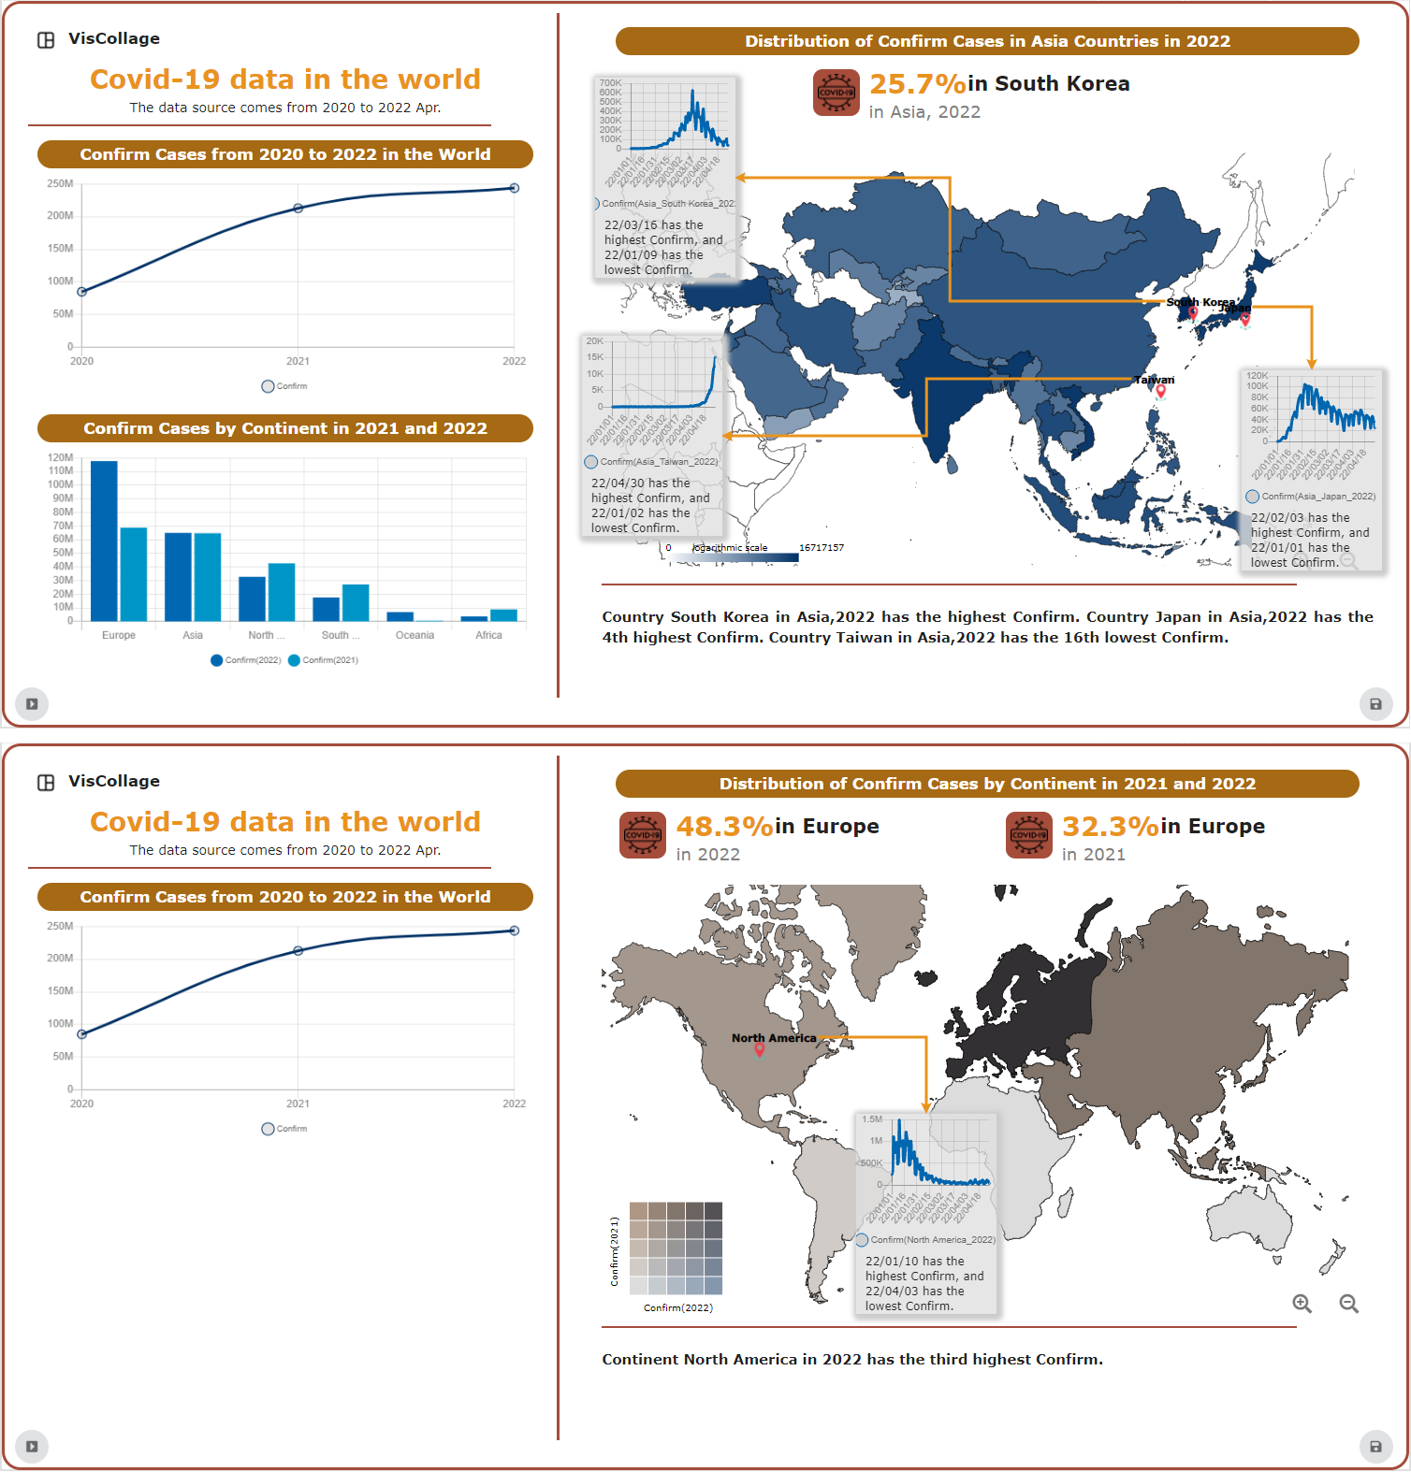
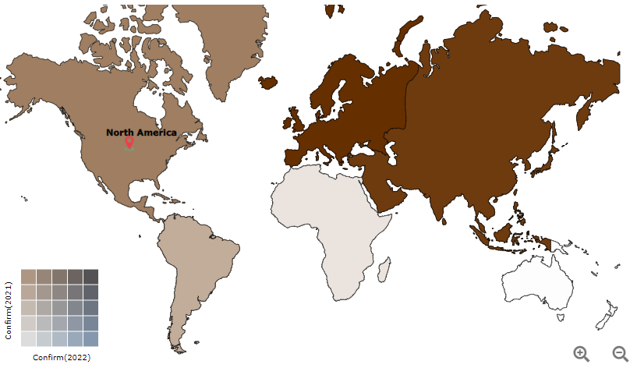
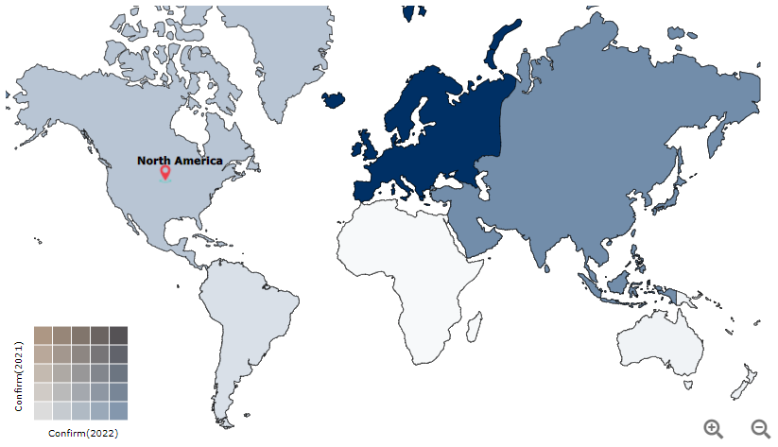

A
VisGuide
B
1
4
2
5
6
3
7
9
8

Slide 20
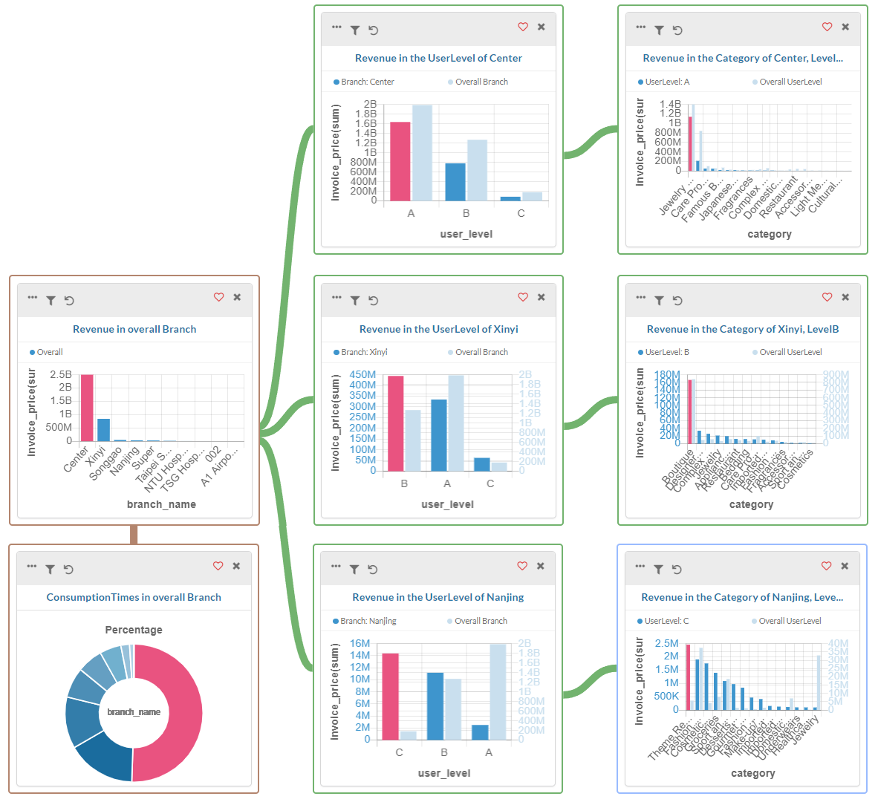
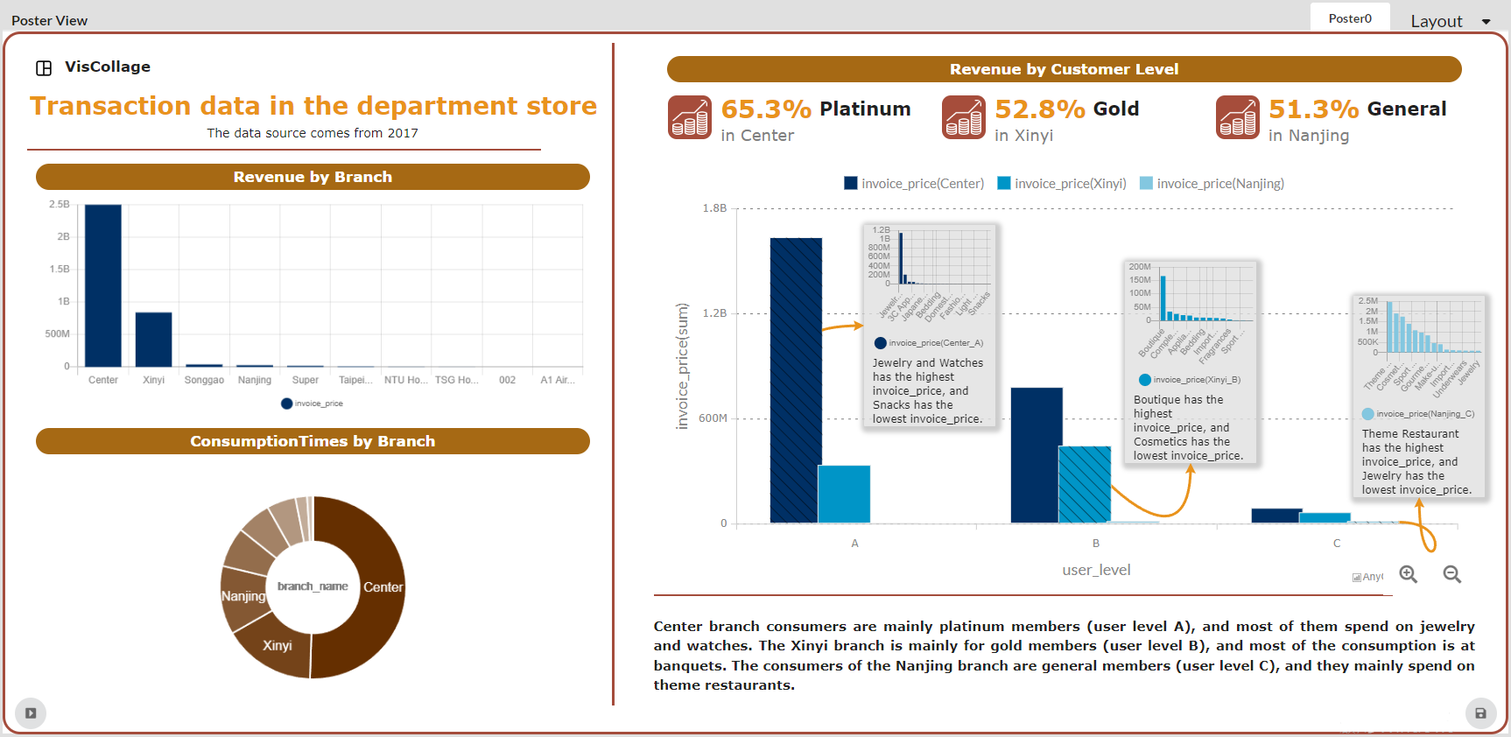
A
VisGuide
B
1
4
2
6
5
3
7

Slide 22
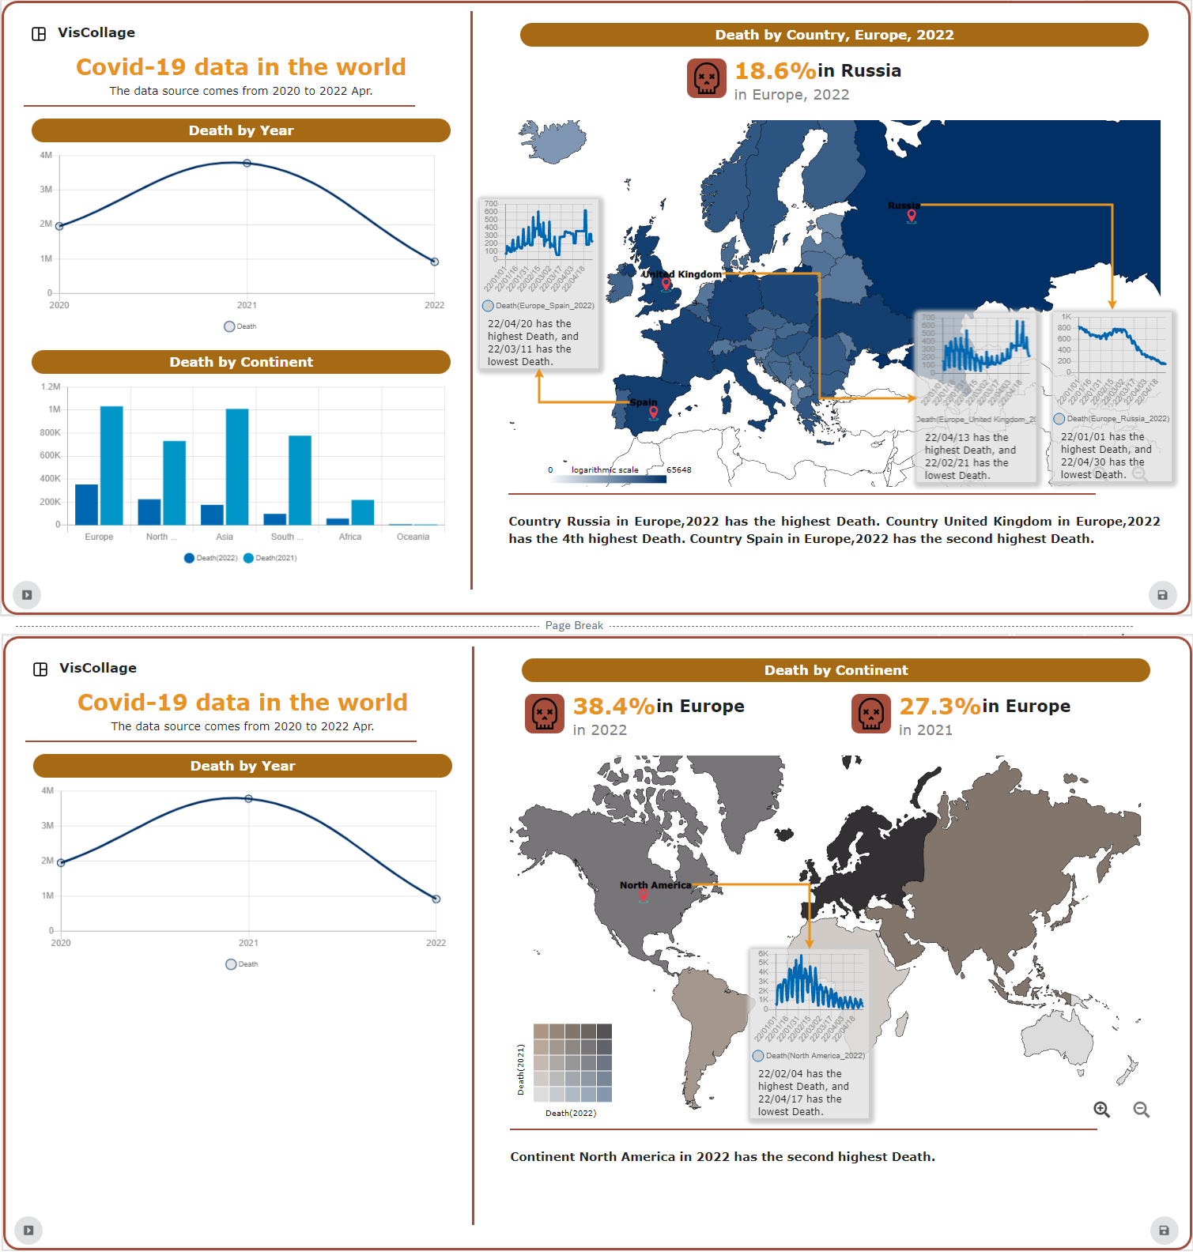
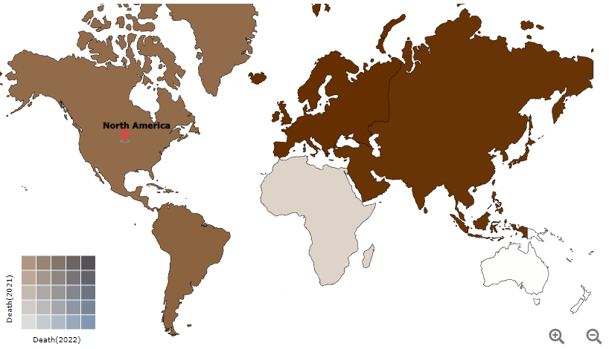
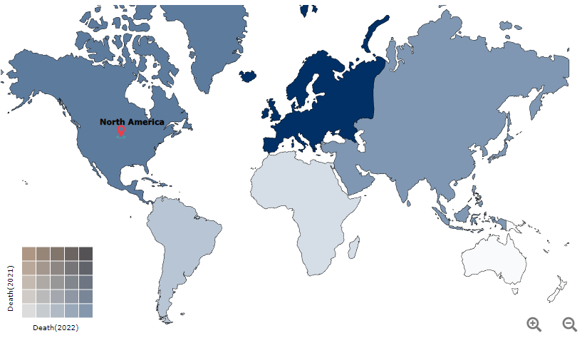

Slide 23
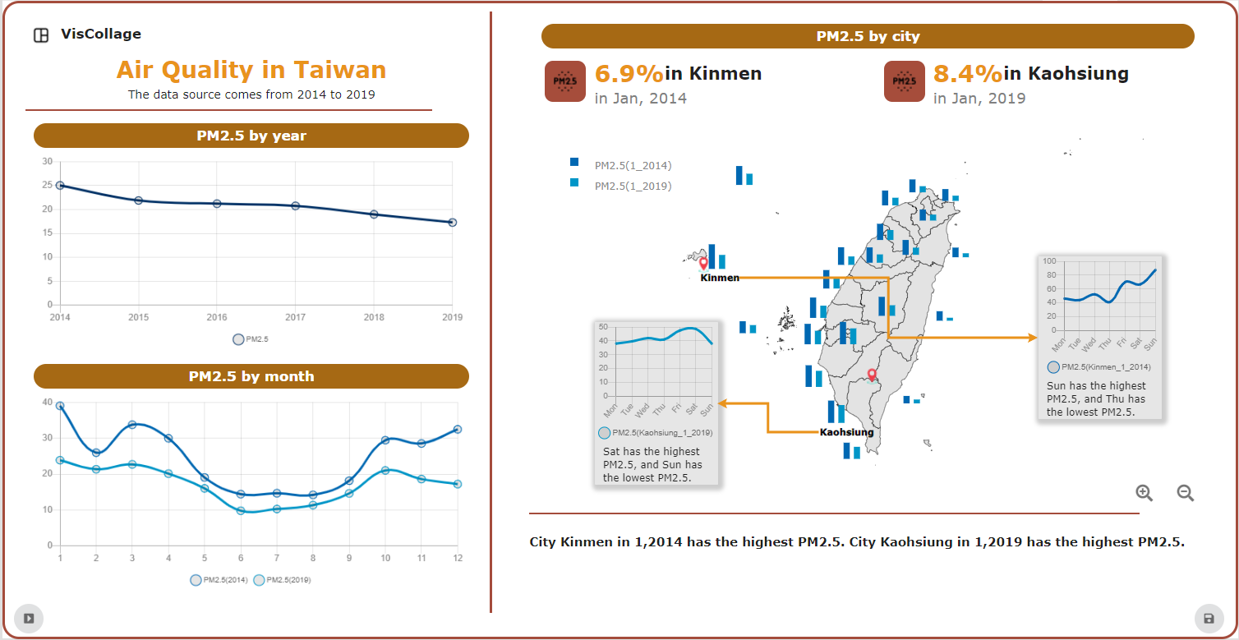
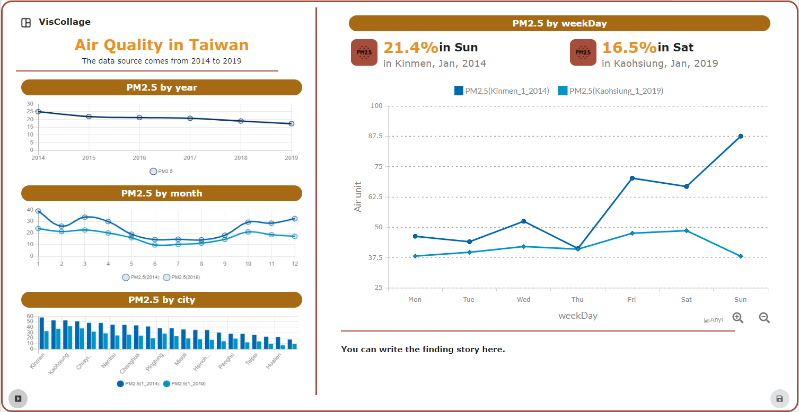
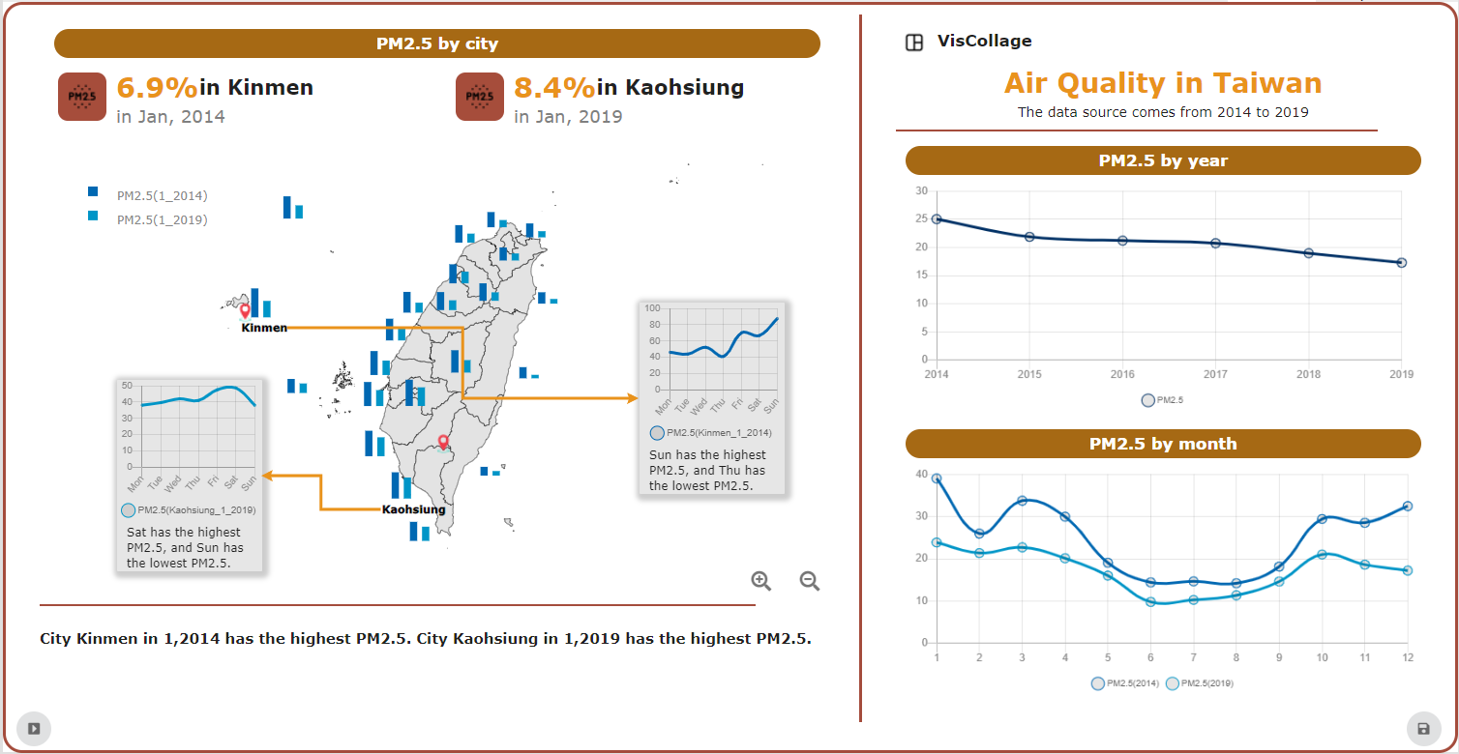
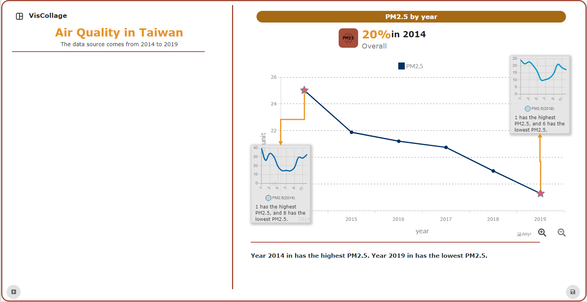
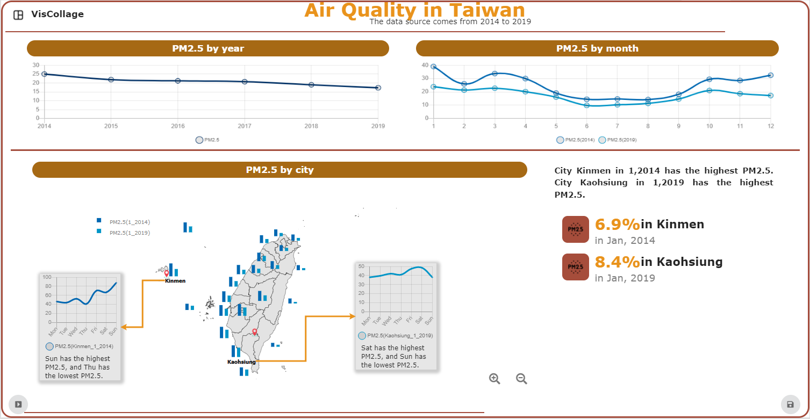
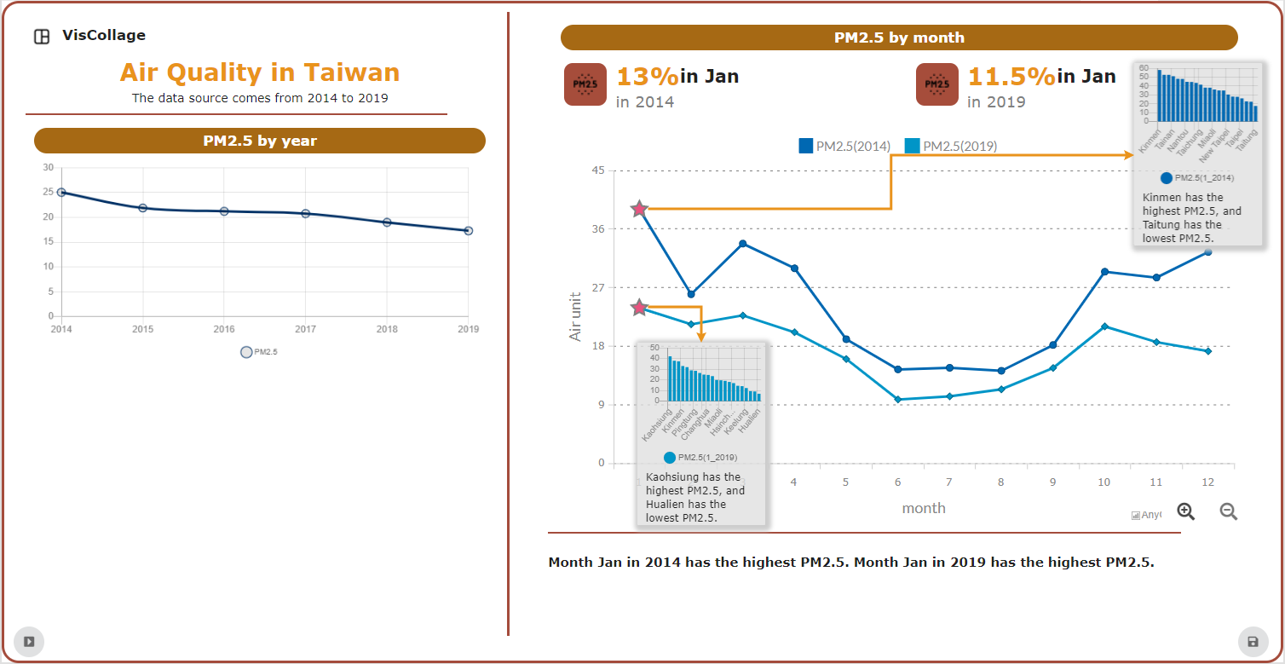
Different Layouts
Different Themes

Slide 24
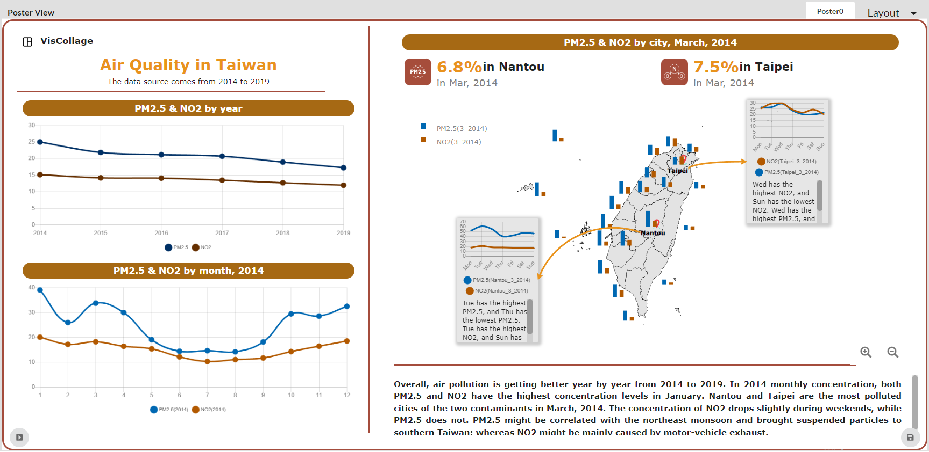
1
4
2
5
6
3
7

Slide 25

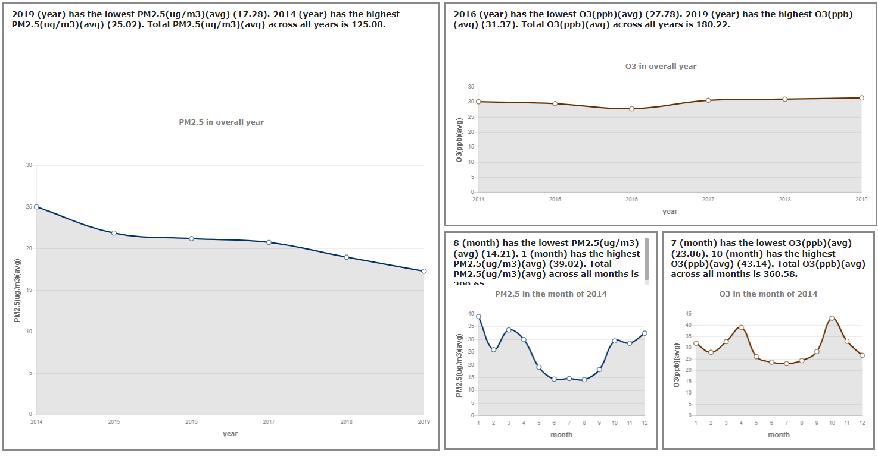
Text Description (文字說明)
Illustration
(插圖)
Annotation Boxes (註解方格)
Titles (標題)
Titles (標題)
Multi-line
(多曲線圖表)
Text Description (文字說明)
Single line
(單曲線圖表)
Visual Collages
Data Comics

Slide 26
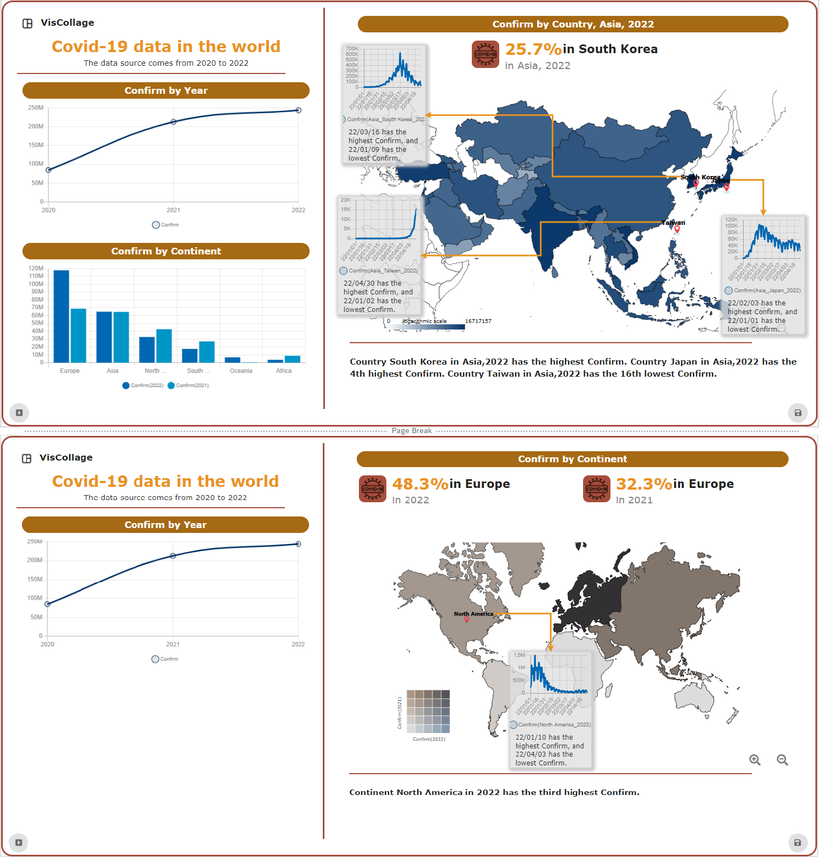
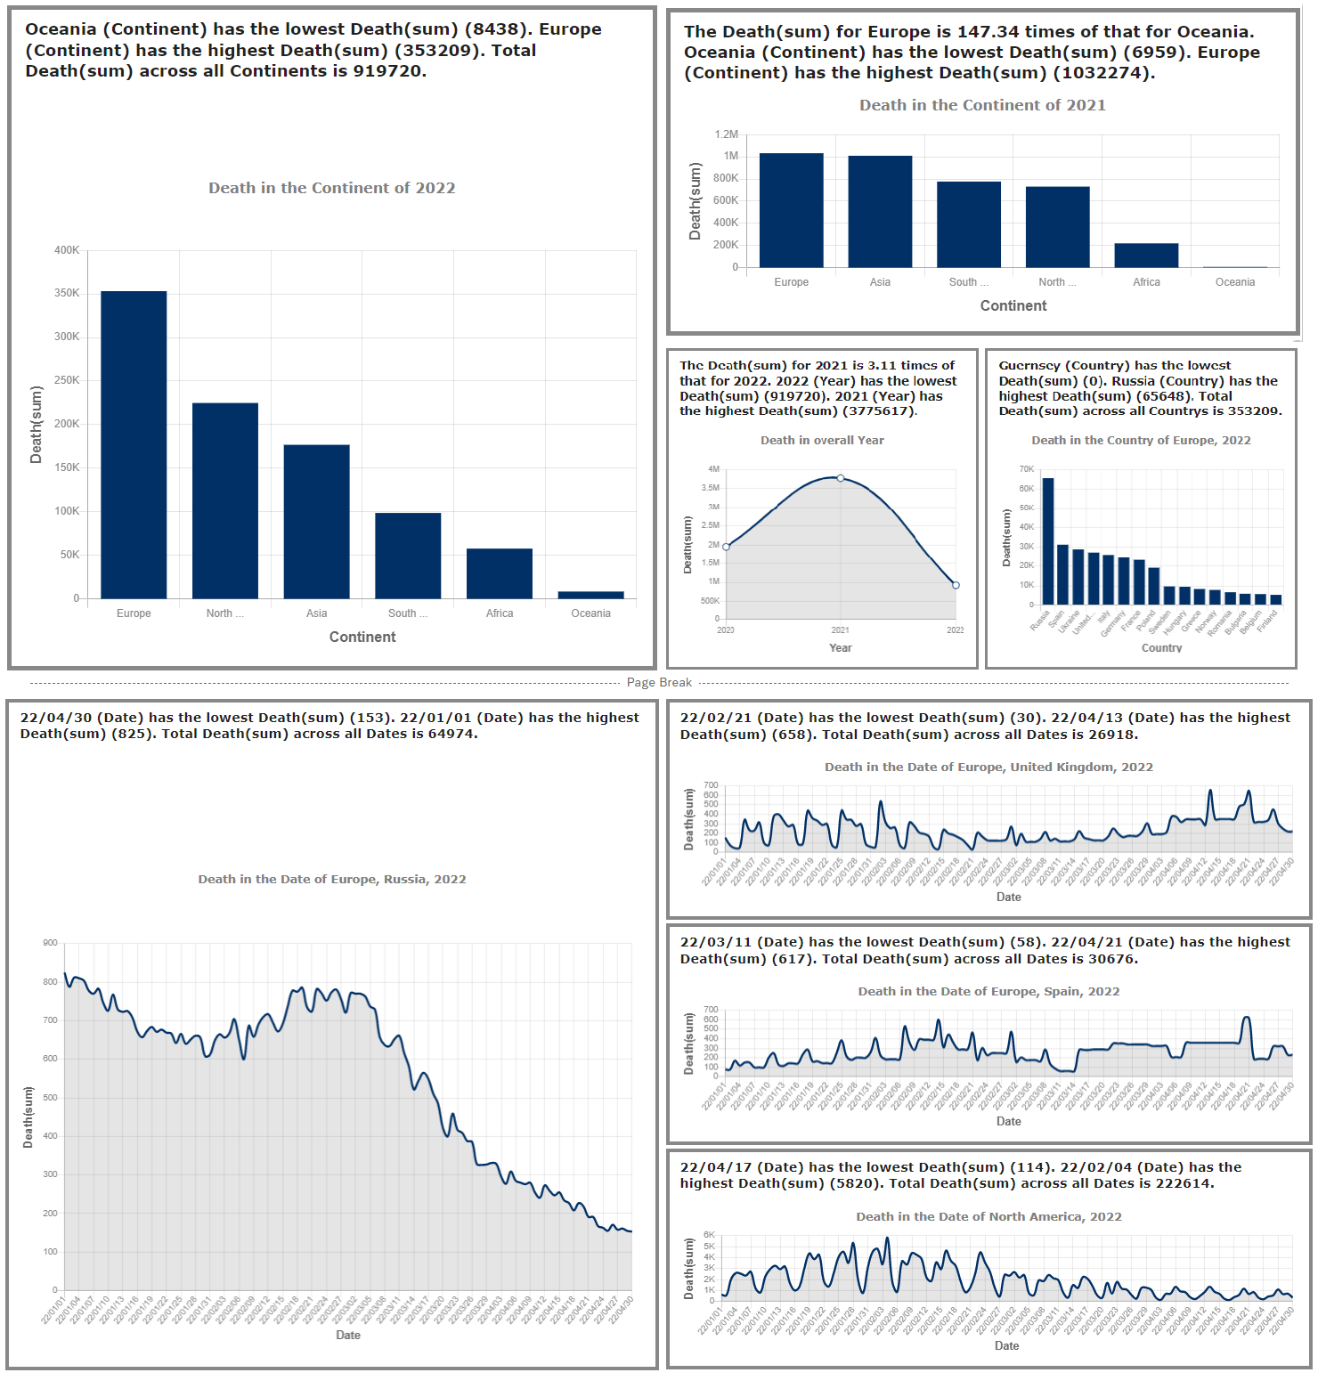
Illustration
(插圖)
Text Description (文字說明)
Annotation Boxes (註解方格)
Titles (標題)
Titles (標題)
Multi-bar
(多曲線圖表)
Text Description (文字說明)
Single bar
(單曲線圖表)
Visual Collages
Data Comics

Slide 27
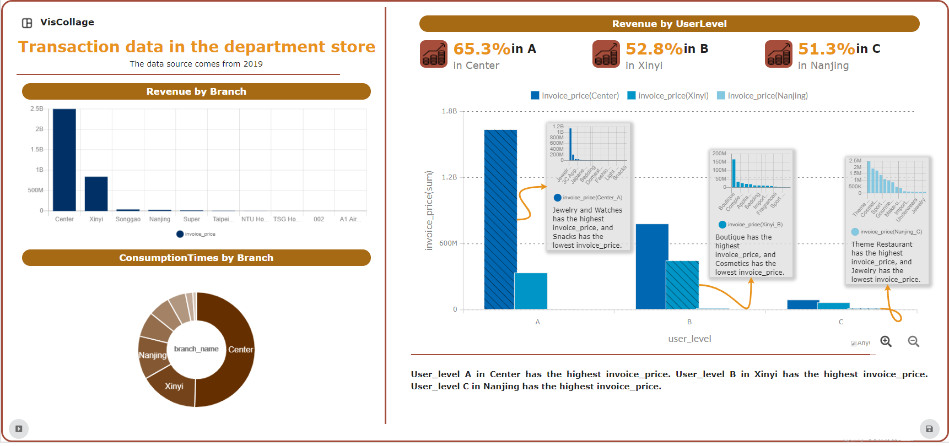
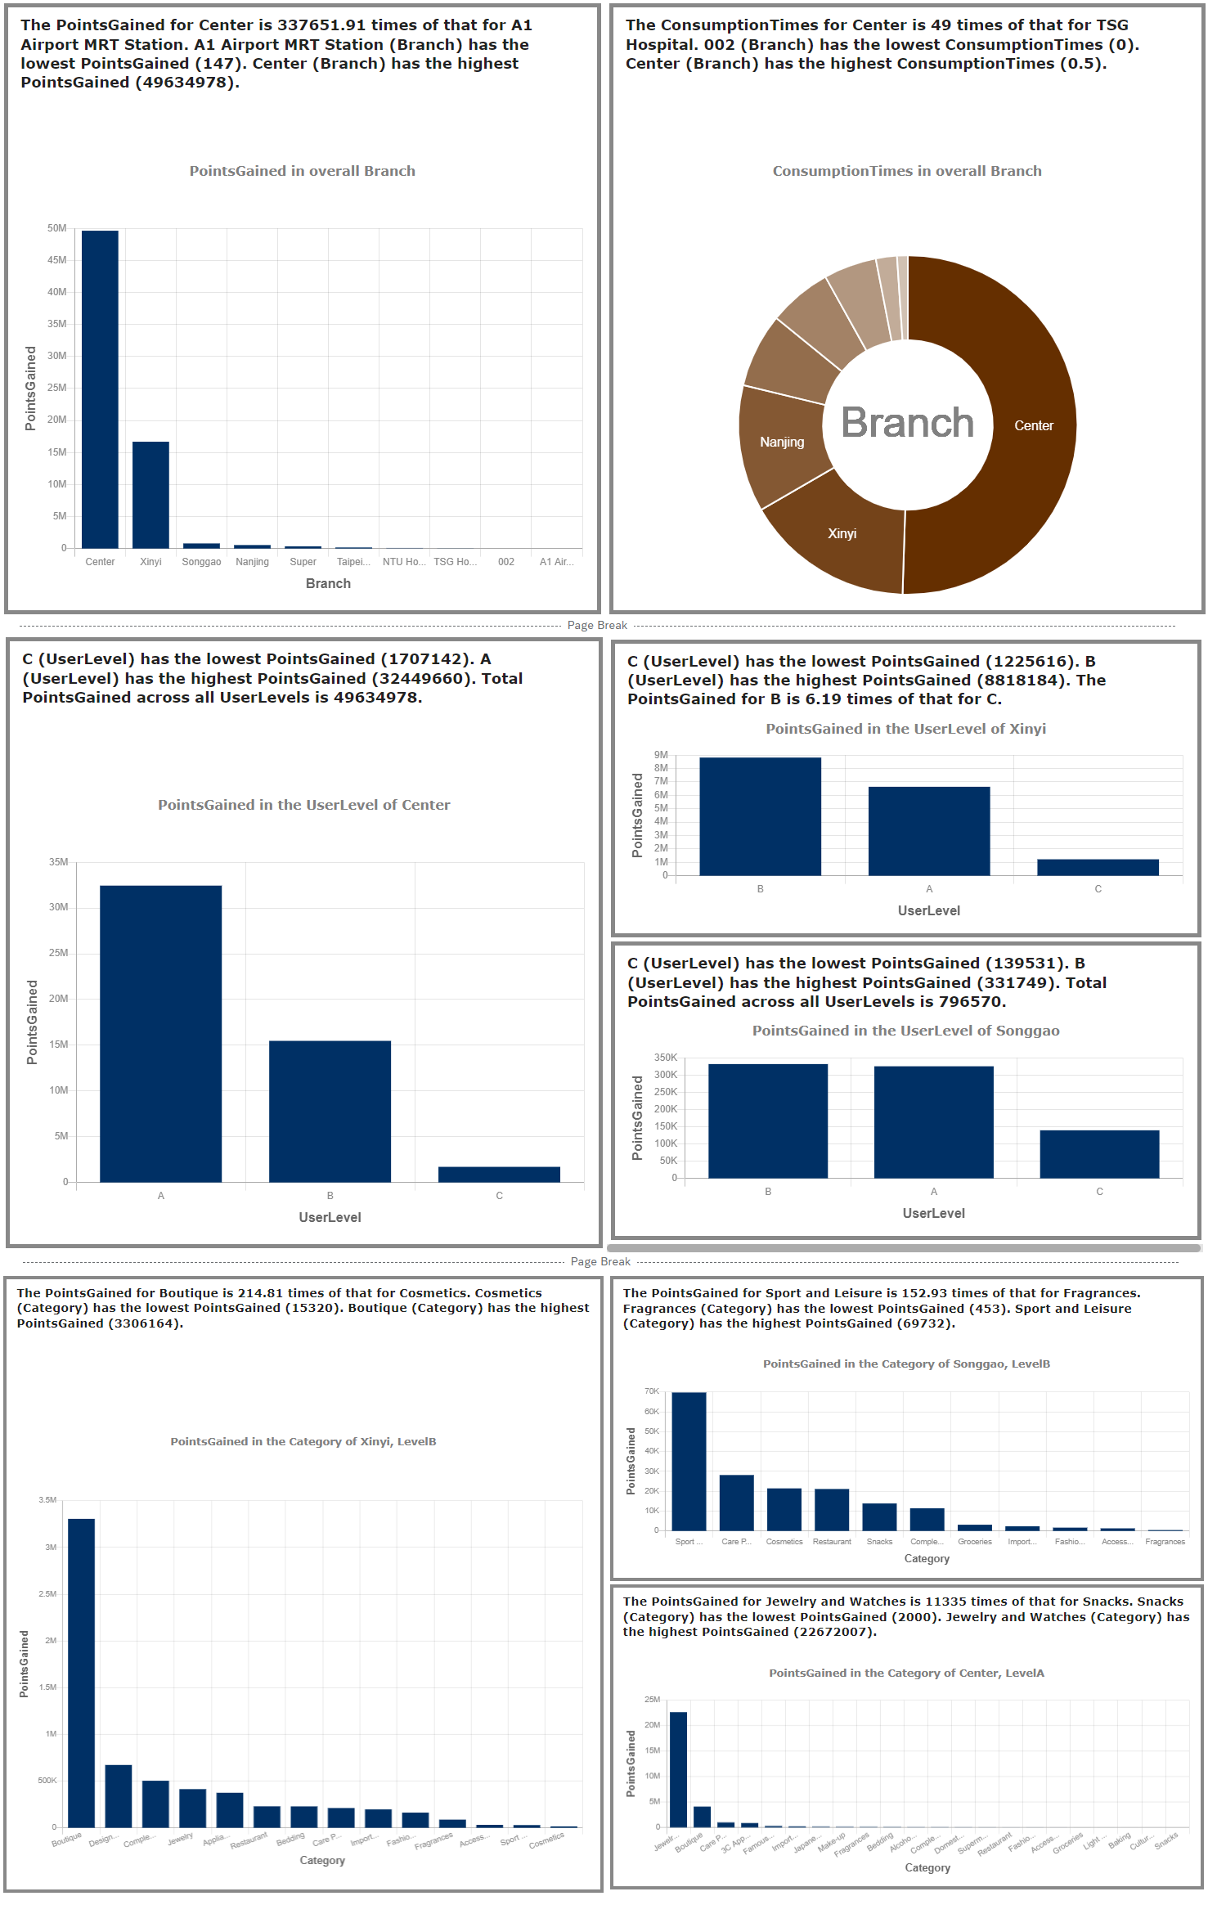
Illustration
(插圖)
Annotation Boxes (註解方格)
Text Description (文字說明)
Titles (標題)
Titles (標題)
Multi-bar
(多曲線圖表)
Text Description (文字說明)
Visual Collages
Single bar
(單曲線圖表)
Data Comics

Slide 28
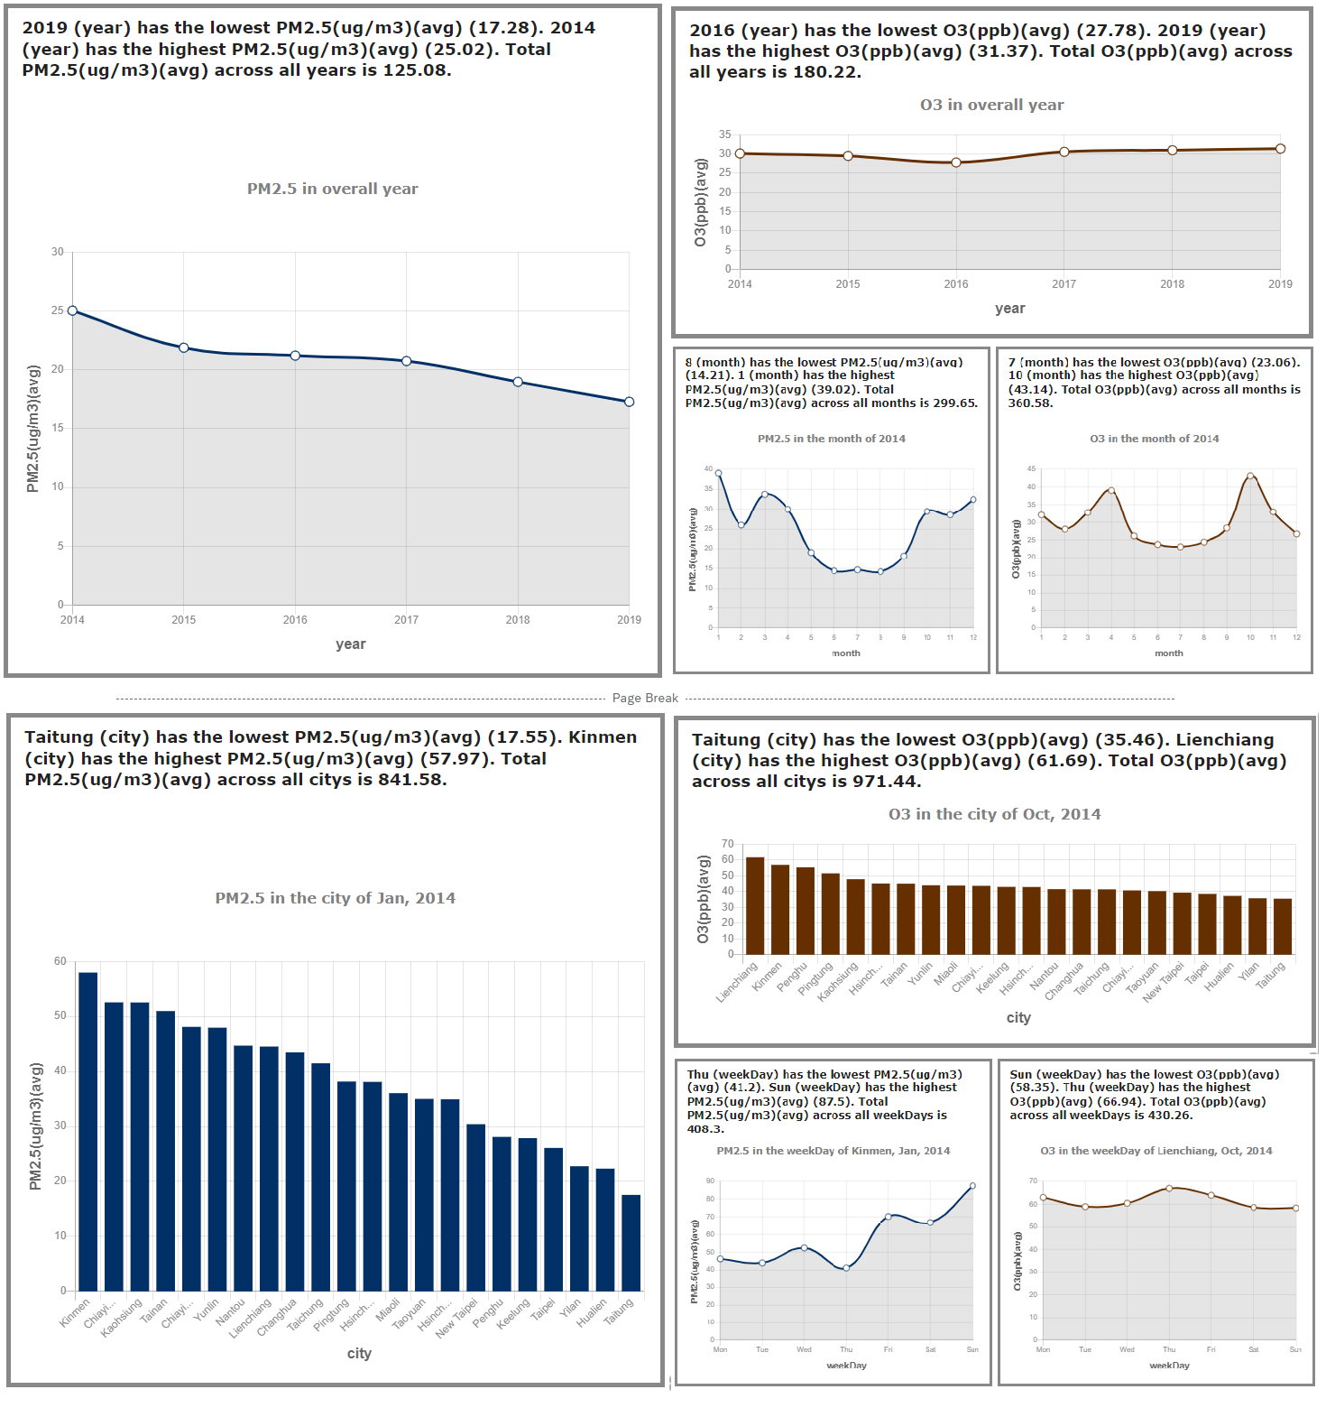
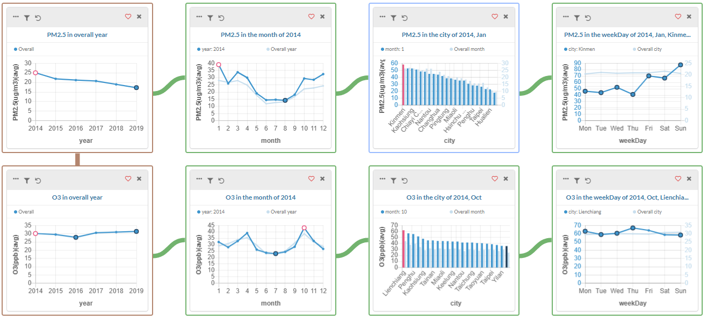
A
VisGuide
B
Data Comics

Slide 29
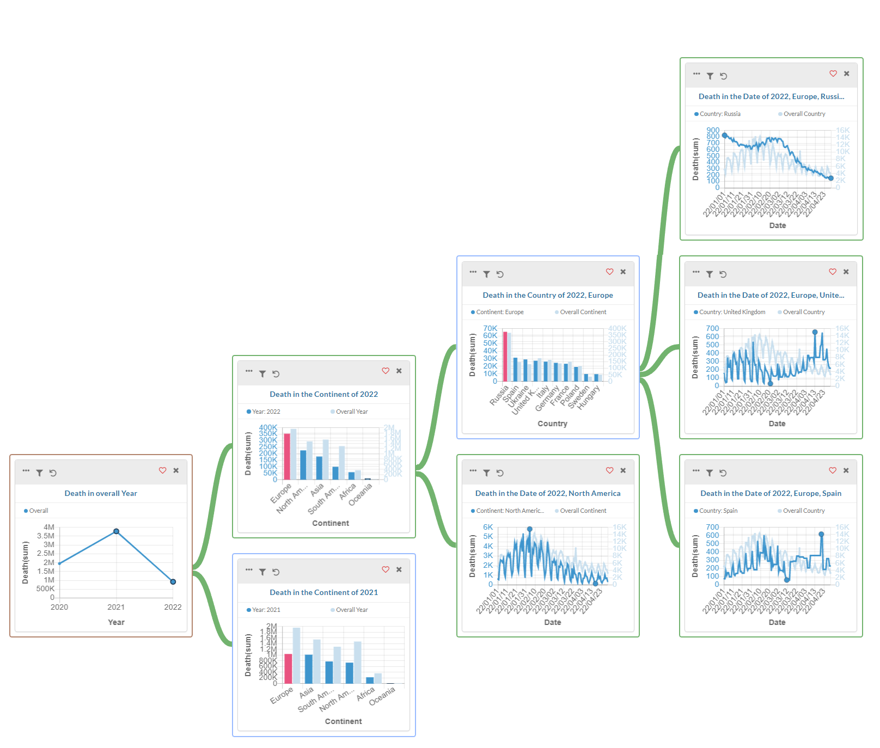
A
VisGuide
B
Data Comics

Slide 30
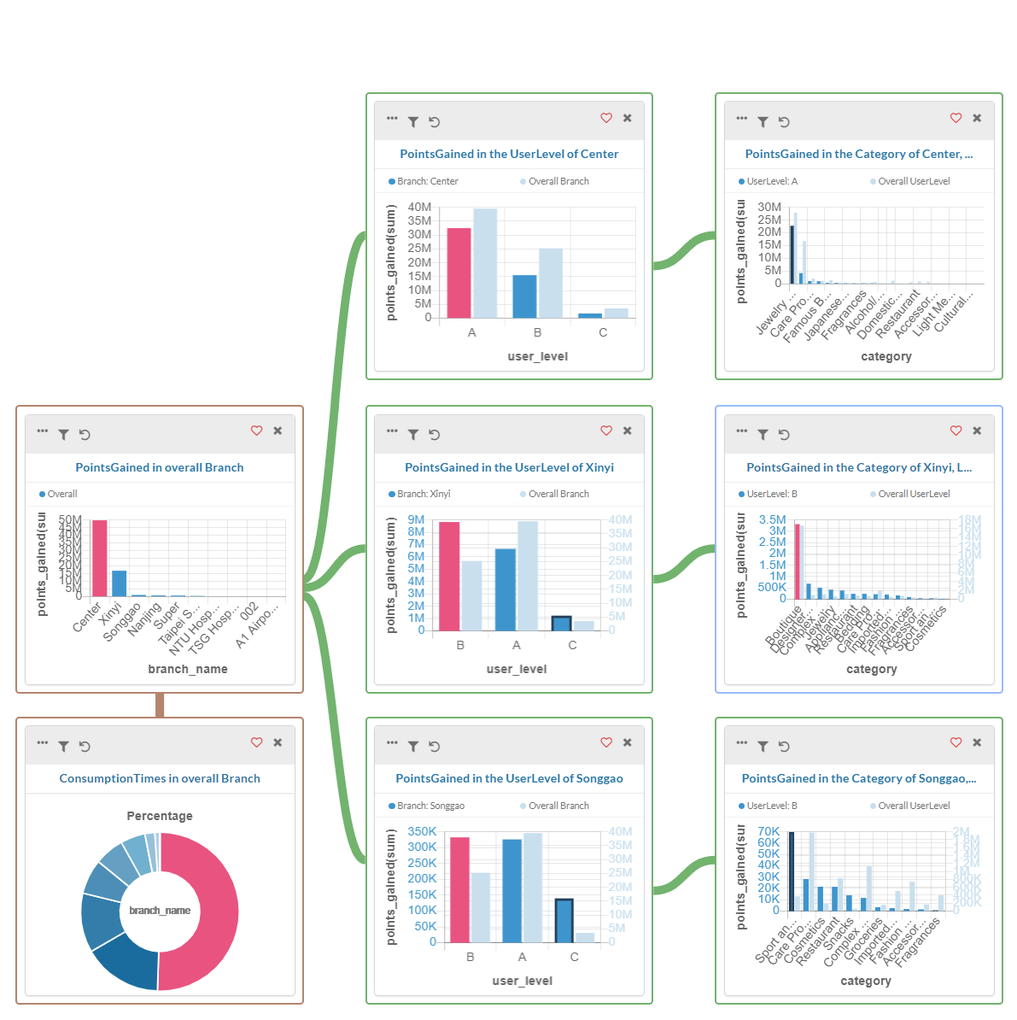
A
VisGuide
B
Data Comics

Slide 31
Evaluation

Slide 32



Visual Collages
Customize
1) Reassembling
2) Rendering
User-Explored
Multi-Vis
VisCollage
Interactive Visualizations
Analysts
Audience
1) Captioning
2) Partitioning
3) Layouting
Customize
Data Comics
Explorers’ Perspective
Designers’ Perspective
Readers’ Perspective

Slide 33
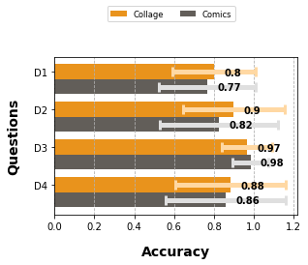
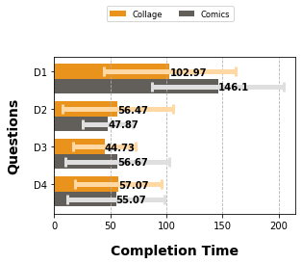
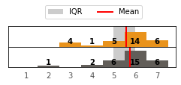
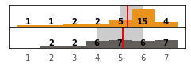
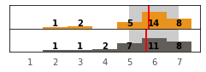
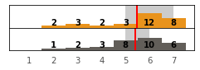
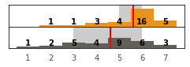
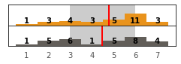
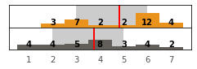
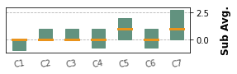
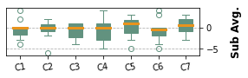
Study 1: Readers
(a)
(b)
C1. Affordance
C2. Compactness
C3. Thematic
C4. Relevance
C5. Configuration
C6. Consistency
C7. Annotation
Personal (Collage-Comics)

Slide 34
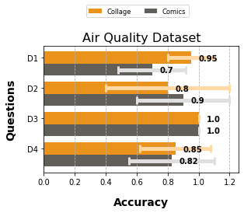
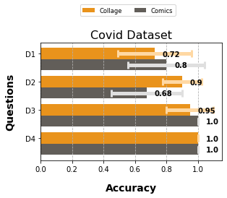
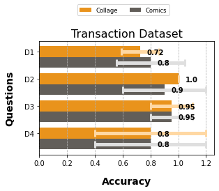
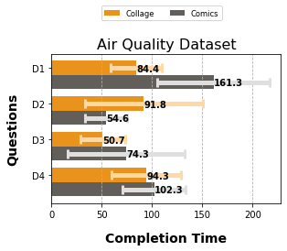
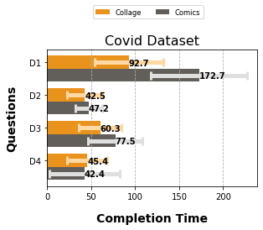

Study 1: Readers

Slide 35
Study 2: Creators
Subtask Descriptions and relevant design principles in Study 2.
S1: Topic Allocating (D1)
Choose the topics that the user wants to focus on.
S2: Layout Selecting (D2)
Choose the layout that the user thinks is the most proper.
S3: AnnoBox Placing (D3) (+ scale + leader line style)
Move the annobox to the most appropriate position.
S4: Caption Writing (D4) (+ illustration text)
Modify stories and headlines to communicate your discovery.

Slide 36

Study 2: Creators
Clustering
Relating
Allocating
Structural Layout
Annotation Placement
Color Consistency
Caption Generation
Affordance
Compactness
Thematic
Relevance
Configuration
Consistency
Annotation
Before Customized
After Customized
Functionality
Study 2: Subjective Rating
Methodology
Challenges
Overall

Slide 37

Study 2: Creators
Clustering
Relating
Allocating
Structural Layout
Annotation Placement
Color Consistency
Caption Generation
Before Customized
After Customized
Affordance
Compactness
Thematic
Relevance
Configuration
Consistency
Annotation
Functionality
Methodology
Challenges

Slide 38










(a) AnnoBox Modified Distance
(b) AnnoBox Modified Path

Slide 39


Study 3: Explorer

Slide 40


Slide 41

Additional Study Findings

Slide 42


All editable captions record
Charts input from VisGuide
Main canvas cluster_id
This page has four theme options
Empty
Main canvas regions info
Collage first page chart info and layout edit logs
Final move position and scale
Layout 1
If the topic has been seen, the info data will fill up
Empty
The last edit and select format

Slide 43





